Slide 2
Objectives
Understand how a bitmap graphic is made up of individual pixels
Explain how each pixel is represented in binary
Understand that the colour depth (bits per pixel) determines the number of available colours for an image
Understand that the resolution is the number of pixels in the image
Explain the relationship between file size, image resolution and colour depth

Slide 3

Starter
Digital images can be stored on a computer in many different file formats
What are five different file formats that can be used?

Slide 4
Image file types
Bitmap image file formats:
BMP
JPG
GIF
PNG
TIFF
Vector image file format:
SVG
There are also editing formats such as Illustrator (AI) and Photoshop (PS)

Slide 5
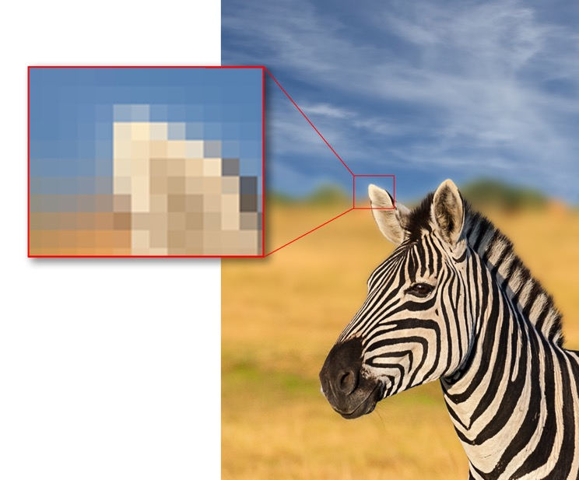
Bitmap (or Raster) images
Bitmap images are made up of PICture ELement or pixels
A pixel is the smallest identifiable area of an image
Each pixel is a single colour and is given a binary value which represents that colour e.g. 111100000000 might equal red
A pixel’s colour can be changed by changing this value

Slide 6
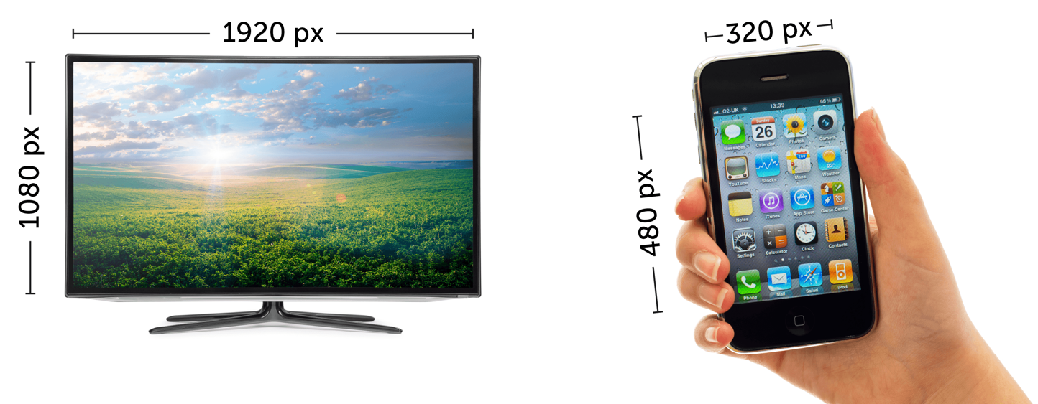

Image resolution
Resolution is the number of pixels in the image
High definition (HD) television uses a resolution of 1920 × 1080 pixels
The first iPhone had a resolution of 320 × 480 pixels

Slide 7
Creating an image
Each pixel is given a binary value
Each value represents a different colour
Using one bit per pixel allows only 2 values, 0 and 1
1 = Black, 0 = White
0 | 0 | 0 | 0 | 1 | 0 | 0 | 0 | 0 | 0
0 | 0 | 0 | 1 | 1 | 0 | 0 | 0 | 0 | 0
0 | 0 | 1 | 1 | 1 | 0 | 1 | 0 | 0 | 0
0 | 1 | 1 | 1 | 1 | 0 | 1 | 1 | 0 | 0
1 | 1 | 1 | 1 | 1 | 0 | 1 | 1 | 1 | 0
0 | 0 | 0 | 0 | 1 | 0 | 1 | 0 | 0 | 0
1 | 1 | 1 | 1 | 1 | 1 | 1 | 1 | 1 | 1
0 | 1 | 1 | 1 | 1 | 1 | 1 | 1 | 1 | 0
0 | 0 | 1 | 1 | 1 | 1 | 1 | 1 | 1 | 0
0 | 0 | 0 | 0 | 0 | 0 | 0 | 0 | 0 | 0

Slide 8
Increasing the number of colours
More bits per pixel = more colour combinations
1 bit = 2 Colours
2 bits = 4 Colours
3 bits = 8 Colours
4 bits = 16 Colours
How many bits per pixel required for 256 colours?
 |  | 10 | 10
 | 10 | 10 | 10 | 10
11 | 01 | 11 | 11 | 01
11 | 01 | 01 | 01 | 01 | 01
11 | 01 | 01 | 01 | 01 | 01
11 | 01 |  |  | 01 | 11
11 | 01 |  |  | 01 | 11 | 11
11 | 01 |  |  | 01 | 01 | 01 | 01 | 01
01 =
10 =
00 =
11 =

Slide 9
Colour depth (bit depth)
Each pixel can represent a finite number of colours
A pixel is attributed a number of n bits
The number of combinations (2^{n}) dictates the bit depth and therefore the number of colours that can be represented
A higher colour depth gives a greater range of colour and a better quality of image
8 bits per pixel = 2⁸ = 256 colours
16 bits per pixel = 2¹⁶ = 65,536 colours
24 bits per pixel = 2²⁴ = 16,777,216 colours

Slide 10
Colours and resolution vs File Size
20 pixels
How does the number of colours affect file size?
How does the resolution of the image affect file size?
20 pixels
8 colours

Slide 11



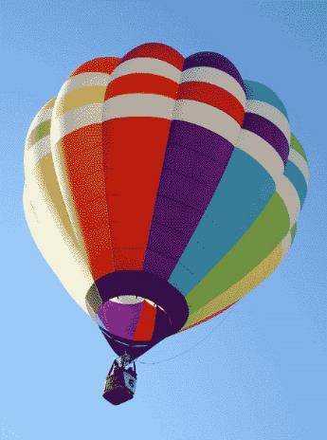
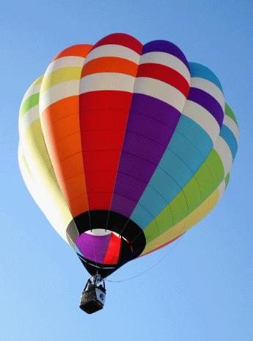
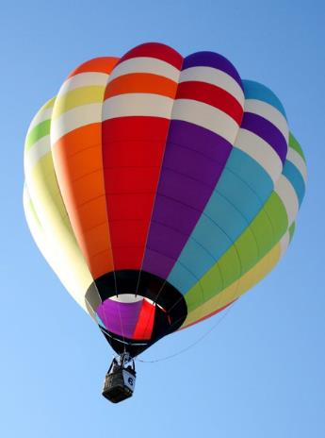
Effects of varying colour depth
Changing the colour depth of an image will affect the number of colours it can display, as shown below:
2 Colours 4 Colours 8 Colours 16 Colours 256 Colours 16.7m Colours

Slide 12
Worksheet 4
Complete Task 1 on Worksheet 4

Slide 13
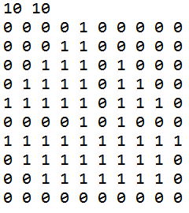
PBM monochrome images
Portable Bitmap (PBM) images store:
The image dimensions
Black or white with a 1 or 0

Slide 14
Representing a monochrome image in binary
A monochrome image can be represented in binary as a bit pattern
The following icon can be represented by the corresponding bit pattern:
0111,
0011,
0101,
1000

Slide 15
Converting a bit pattern into a monochrome image
Convert the following bit pattern into an 8 × 8 icon:
00000011
00000101
00001010
01010100
01101000
00110000
01011000
10000000

Slide 16
Converting a bit pattern into a monochrome image
Convert the following bit pattern into an 8 × 8 icon:
00000011
00000101
00001010
01010100
01101000
00110000
01011000
10000000

Slide 17
Worksheet 4
Complete Task 2 on Worksheet 4

Slide 18
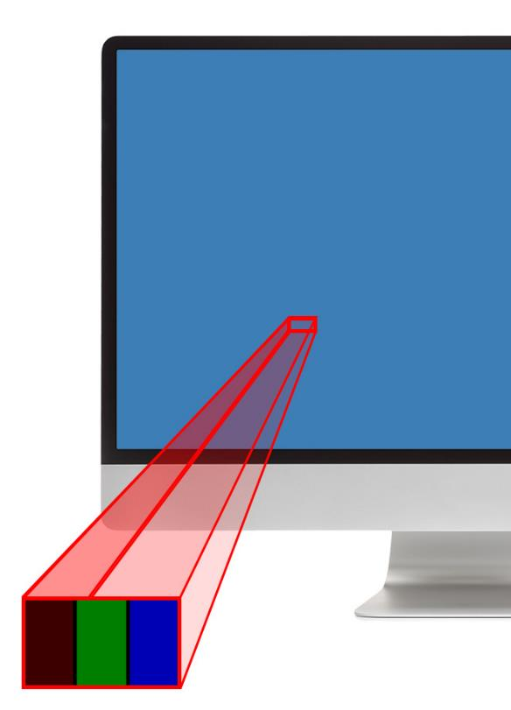
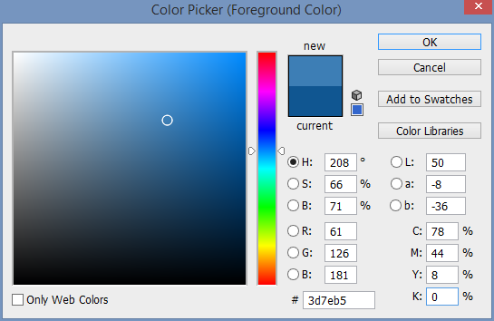
Colours
Each pixel has a proportion of red, green and blue
From a distance, it makes up one colour
One pixel
61
Red
126
Green
181
Blue

Slide 19
Looking at colour values
Colour values of individual pixels are expressed in software as denary RGB values and in hexadecimal
Why isn’t binary used in this instance?
RGB (Red, Green and Blue) values range between 0-255
How many bits are required for each of the red, green and blue components of a pixel?
How many bits are required for the whole pixel?

Slide 20
Looking at colour values
Software colour pickers are used by designers and developers
They use numerical values and hex as these are easier for people to read, write and remember and reduce errors if copied
RGB values between 0-255
Each colour requires 8 bits to store the range 0-255
The whole pixel requires 3*8 = 24 bits (16.8 million colours)

Slide 21
Plenary
Fill in the gaps in each of the below sentences:
A bitmap graphic is made up of __________________
Each _______ is represented in binary
The ________________________ determines the number of available colours for an image
The greater the _________ of the image, the greater the file size

Slide 22
Plenary
A bitmap graphic is made up of individual pixels
Each pixel is represented in binary
The colour depth determines the number of available colours for an image
The greater the resolution of the image, the greater the file size

